Slide 1
FLORIADE PROJECT GROUP 2
Ana Maria Nitu, Bianca Onea, Stela Trencheva,
Matei Mitran, Vid Barbaro

Slide 2
01
INSIDE THE FOREST

Slide 3
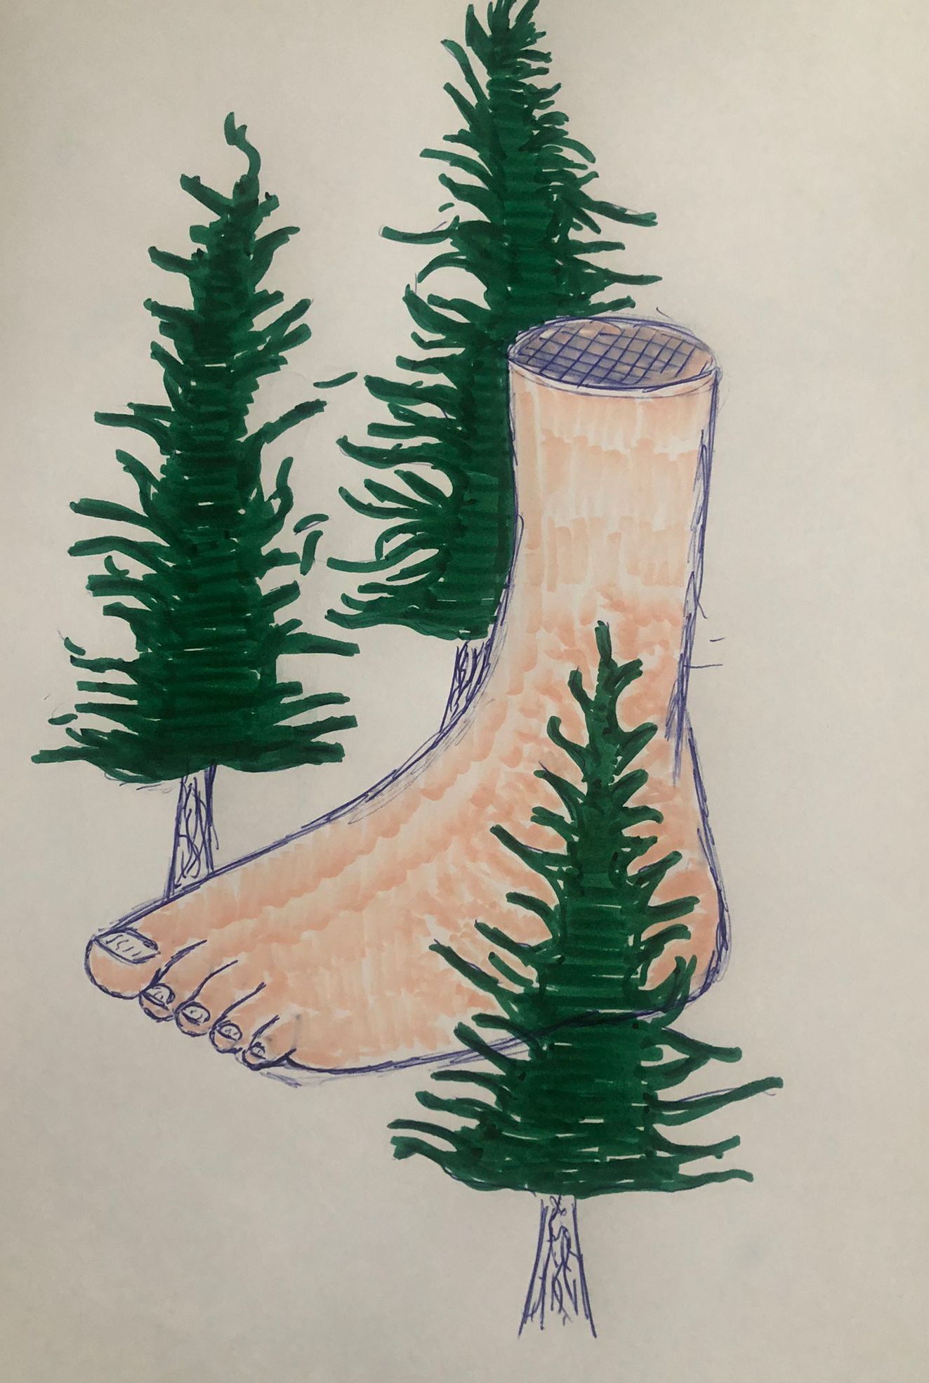
THE IDEAL SOLUTION...

Slide 4
...THAT POSES LOTS OF PROBLEMS
Problems:
Occlusion issues
A designated space would have to be marked on the floor
Both of the problems are not solvable easily or at all. 5 hectares is too big of a space to be marked and not interfered by people, and occlusion is a general problem in AR development.

Slide 5
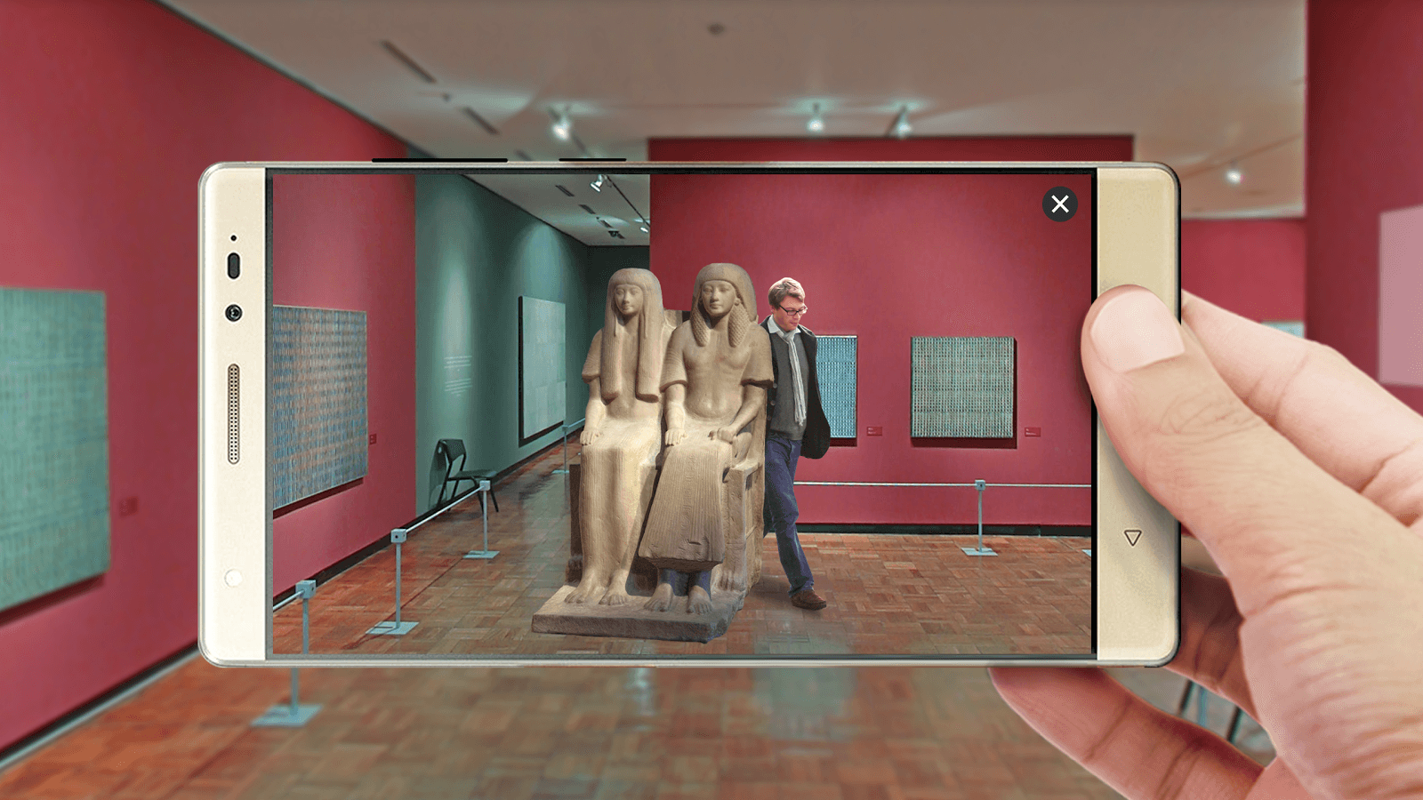
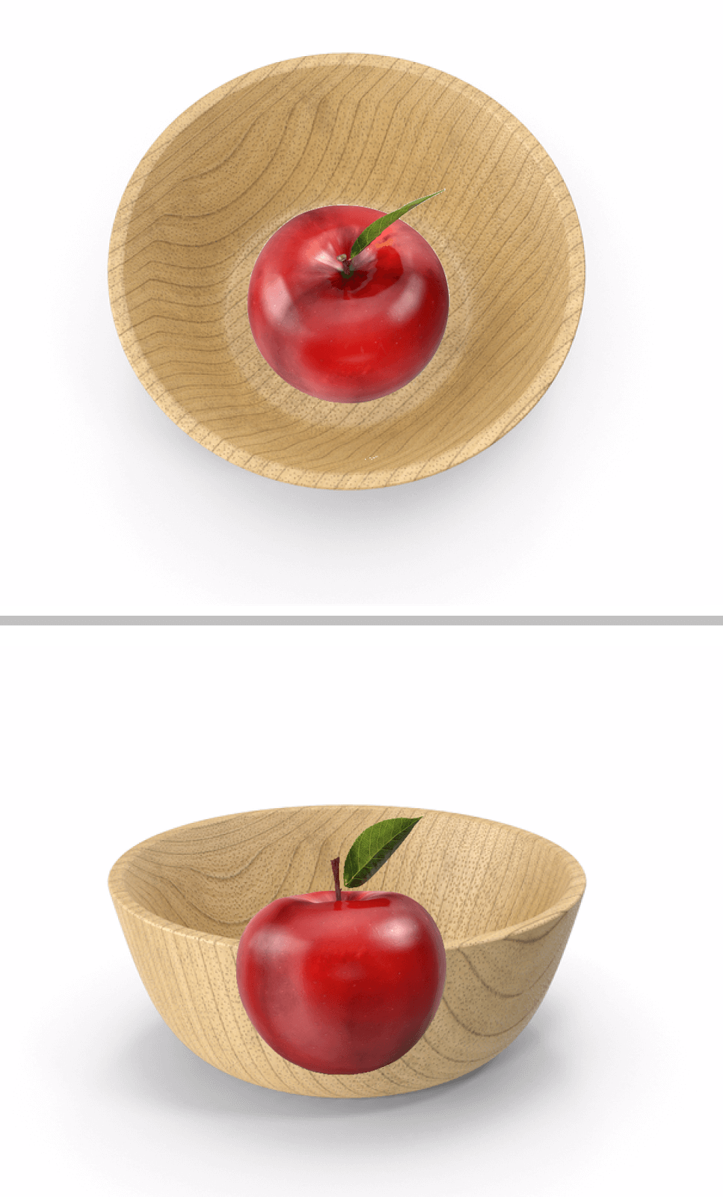
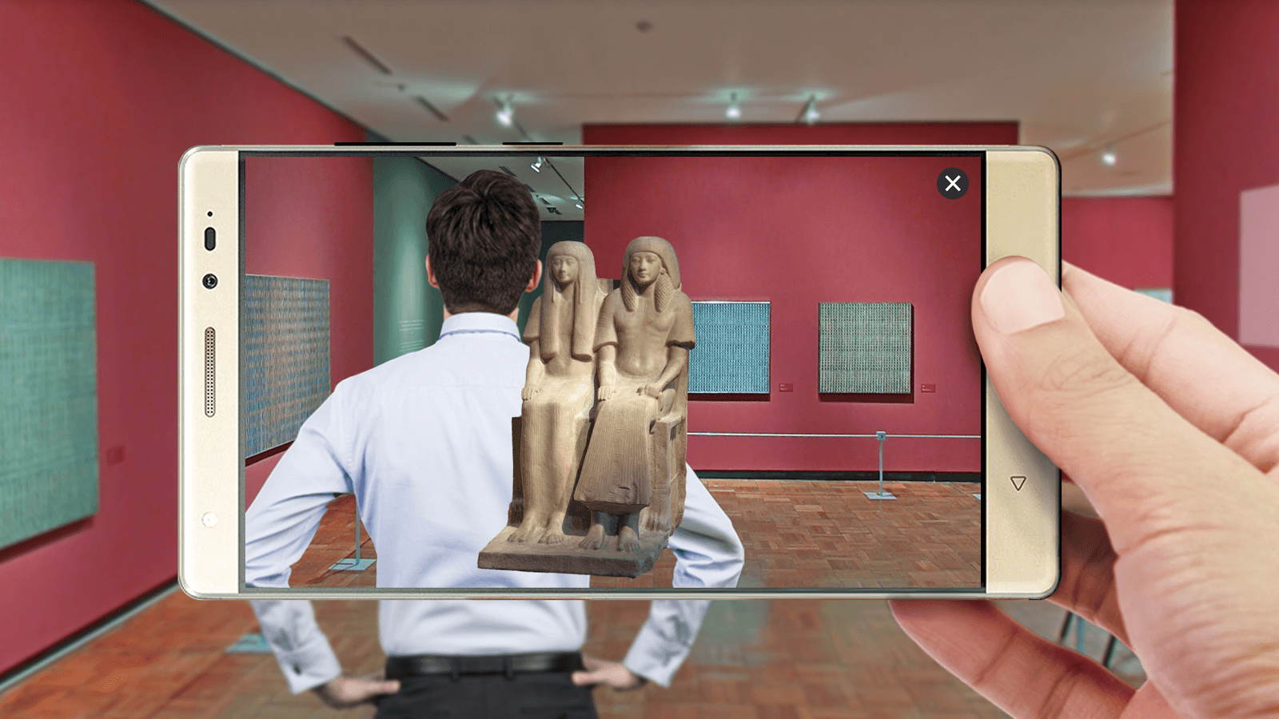
WHAT IS OCCLUSION?

Slide 6
02
LEVITATING ABOVE THE FOREST

Slide 7
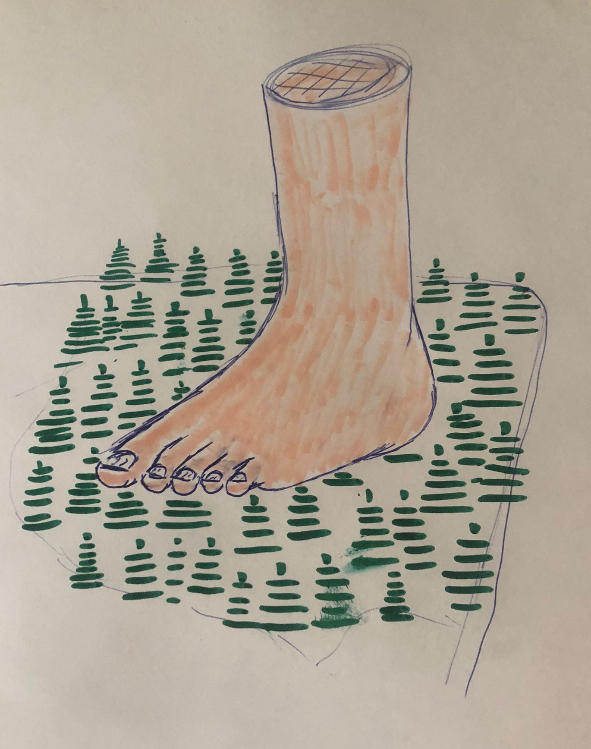
A POSSIBLE ALTERNATIVE

Slide 8
DOABLE BUT LIMITS USER FREEDOM
PROS
CONS
Occlusion issues would be avoided
Still shocks users with the size of the foot
Looks good from far away and higher surfaces
Experience of walking up to the foot won't be possible
Foot won't look good from mid to short range since the trees in the forest will interfere and cause occlusion

Slide 9
03
MAKING THE FOOT TRANSPARENT

Slide 10
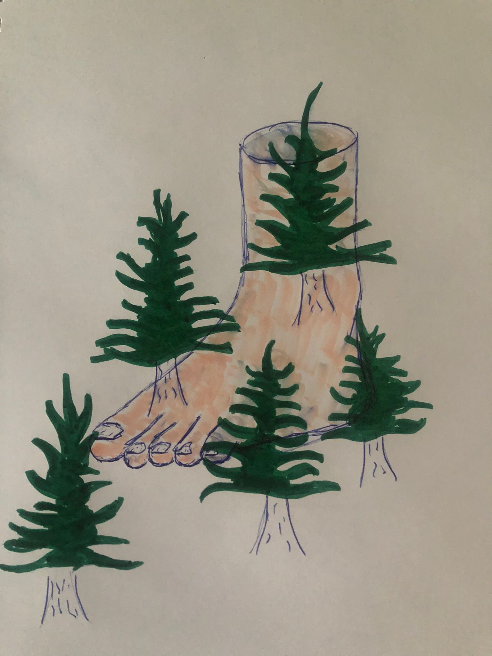
COULD BE A REALLY GOOD SOLUTION

Slide 11
POSSIBLE SETBACKS AND SOLUTIONS
Issues:
We can't know if it will look good or bad before making the prototype
Possible pros:
It could solve occlusion issues
It could make the experience for users good from almost all points of views

Slide 12
04
MAKING THE FOOT AVAILABLE EVERYWHERE

Slide 13
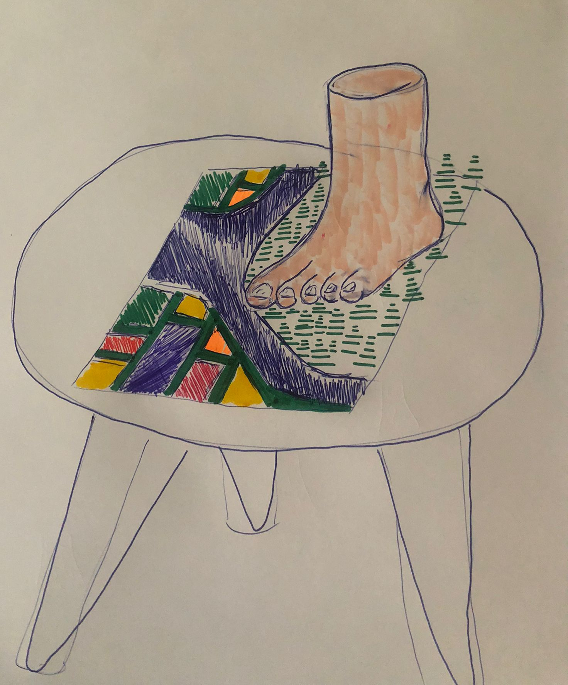
TAKING A DIFFERENT APROACH

Slide 14
WHY IS IT GOOD?
OCCLUSION ISSUES
COULD TELL A STORY
MAKES IT AVAILABLE EVERYWHERE

Slide 15
WHY IS IT BAD?
NO SIZE SHOCK FACTOR
NO WALKING UP TO THE FOOT
NOT AS UNIQUE

Slide 16
THANK YOU!

